Slide 1

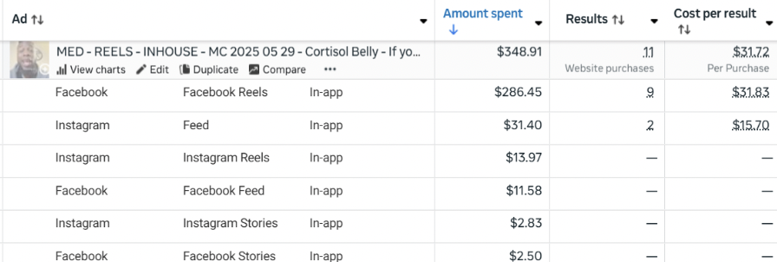
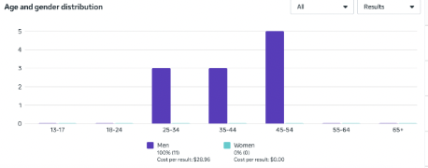
YOUR TITLE HERE - Replace with your actual title
Spend - $50.00
CAC (Hyros Scientific) - $63.00
CAC (Hyros Last Click) - $41.00
CAC (Clicks Only - Northbeam) - $10.00
CAC (Last non-direct touch - Northbeam) - $130.00
New Visits (Northbeam) - 13.00%
ECR (Northbeam) - 53.00%
Date Created - July 30, 2025
AA1
FB Link
IG Link

